Slide 1
Genre Classification
Tyler Perkins

Slide 2
Problem Description
Being able to classify music by genre is an important feature of any music streaming service
Whenever new music is uploaded, an algorithm can determine the genre automatically
This allows music to be organized and discovered more easily

Slide 3
Methods and algorithms
Using GTZAN genre collection (http://marsyas.info/downloads/datasets.html)
Contains 1000 song samples from 10 genres
Convert audio samples to melspectrograms for features
Prediction:
K-Nearest Neighbor
Convolutional Neural Network

Slide 4

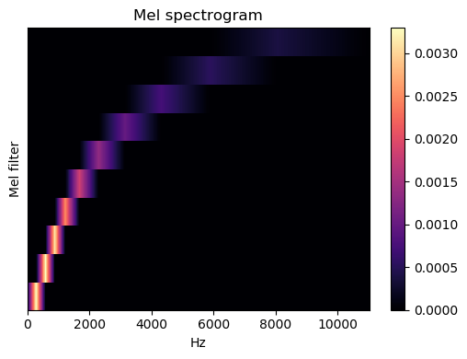

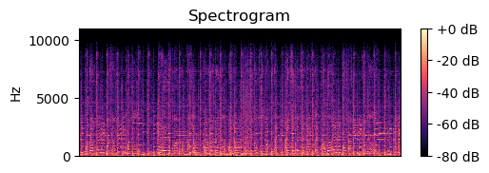
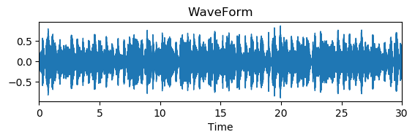
Melspectrograms
Uses librosa package
Spectrogram: 2D representation of audio using frequency over time
Mel-Scale: Non-Linear transformation of frequency scale, converts frequency in to “mels”
No set formula, something in the form

Slide 5
K-Nearest Neighbor
Supervised Algorithm
KNN algorithm assumes that similar things exist in close proximity
Compares distance between features to classify data
Using scikit learn KNeighborsClassifier

Slide 6
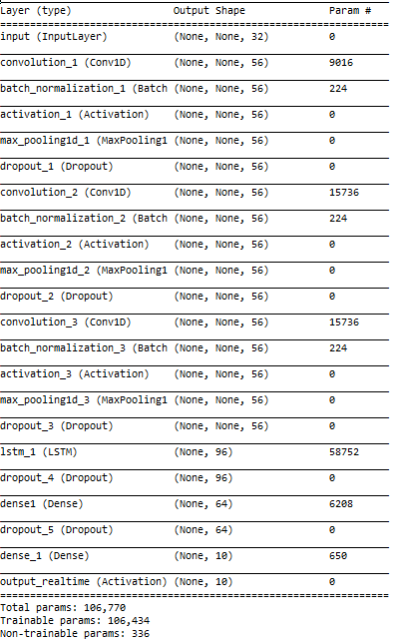
Convolutional Neural Network
3 Conv1D layers
LSTM Layer
Dense Layer
Softmax
Optimizer: Adam with learning rate of .001
Loss: Categorical Cross Entropy
200 epochs

Slide 7
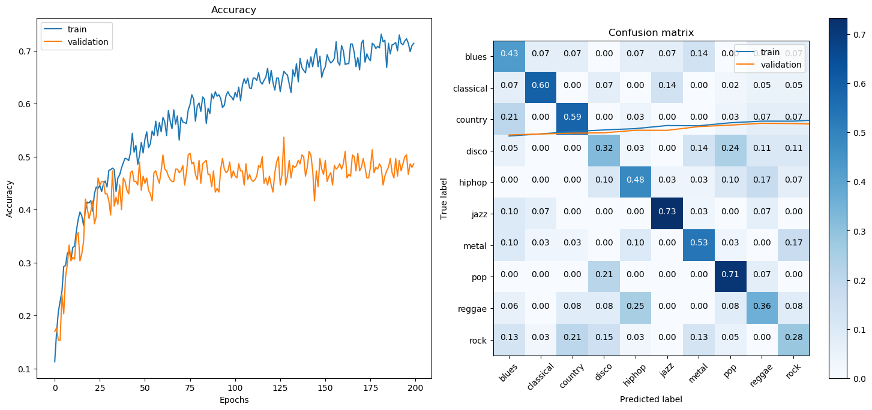
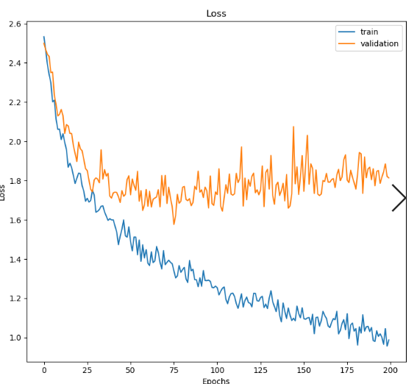
CNN Results

Slide 8
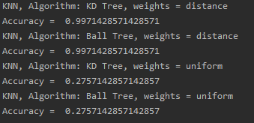
kNN Results
Compared 2 algorithms for computing nearest neighbor and 2 types of weights

